Slide 1
Emotion Recognition from visual Big-Data using Convolutional Neural Network
Vinay Ramasare Kurmi
Student No : 10576078

Slide 2
Table of Contents
Table of Contents
Abstract
Motivation
Problem Statement, Research Question, Hypothesis
Project Life-cycle
Data Collection
Data Pre-processing
Feature Extraction
Classification Accuracy & Validation Loss
Conclusion
Confusion Matrix
Live Prediction
Future Work

Slide 3
ABSTRACT
ABSTRACT
The field of research in AI dealing with human-machine interaction for emotions is called Affective Computing.
Propose a system to recognize emotions in real-time.
Impact of emotions on intellectual processes.
It can be performed in real-time using various sorts of data: images, videos, text, audio etc.
We train our model on the FER 2013 dataset available on Kaggle.
Use Cases: Digital Advertisement, Online gaming, Healthcare, Deep Fake Detection, Effective Learning System.

Slide 4

Motivation!
Motivation!
Business and Organizations
Product & Service benchmarking
Market Intelligence
Advertisement
Interactive ads to customer
People
Opinion on new product
Opinion on topics
Healthcare
Gaming
Effective Learning

Slide 5
Problem Statement
Problem Statement
Identify various emoitons in a real-time environment.
Fetaure extraction is one of the most important part of emotion recognition.
Research Question
Idenfity suitable methodologies for emotion recognition from images ?
Data pre-processing techniques to identify best features ?
Hypothesis
Test whether CNN suits our goals to build a robust & scalable real-time emotion recognition system.

Slide 6
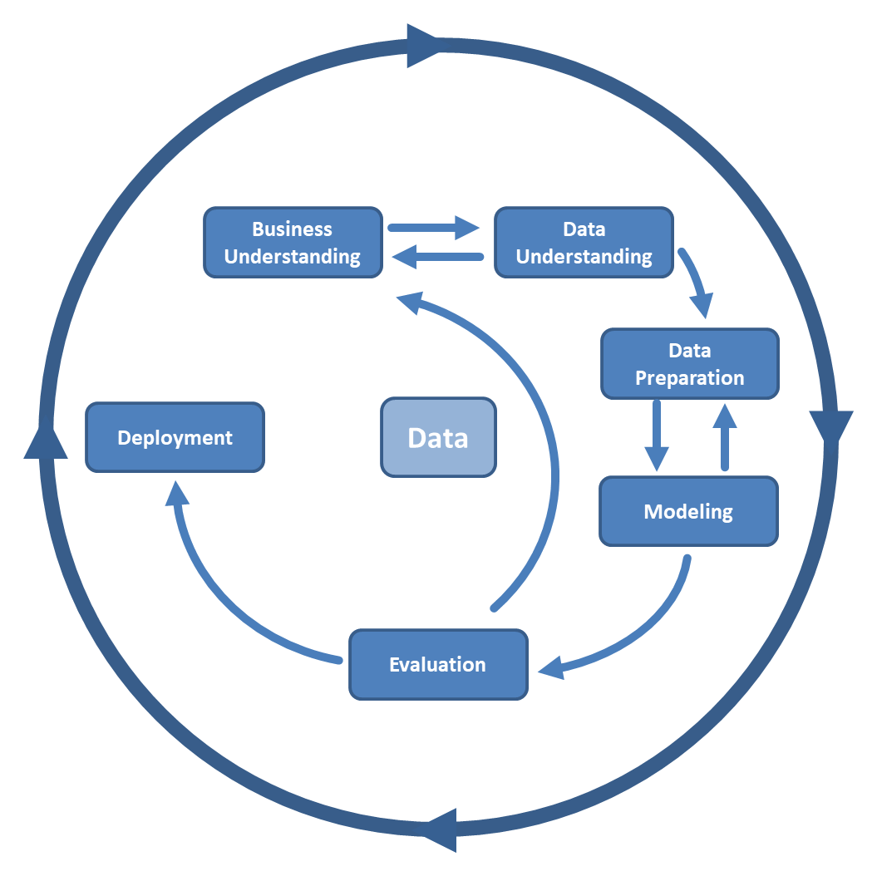
Project Lifecycle

Slide 7
Size: 48 X 48 pixel images
28,000 Training Images
35,000
Source : Kaggle
7 emotions: happy ,sad, neutral, surprise, fear, angry,disgust
7,000 Testing / Validation Images
Total Images!
Data Collection
Data Collection

Slide 8
Data Pre-processing
Reshaping Images
Face Allignment
Class Weighting
1
3
5
2
4
6
Data Augmentation
Face Normalization
Fitting the Generator

Slide 9
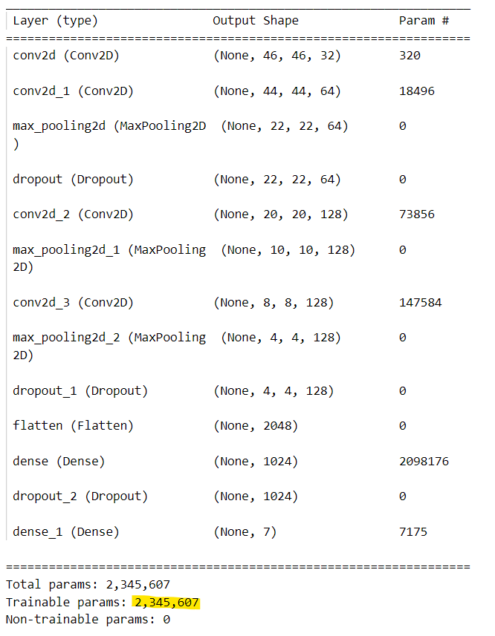
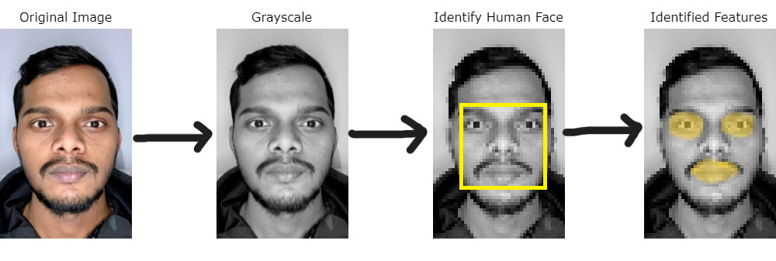
FEATURE EXTRACTION
FEATURE EXTRACTION
BACKGROUND NOISE
GRAYSCALE
RESIZING
IDENTIFY FACE
IDENTIFY ESSENTIAL PARTS
SELECT PARAMETERS

Slide 10
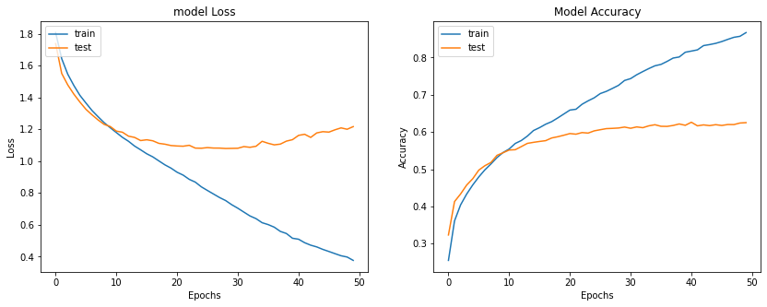
Classification Accuracy & Validation Loss
Classification Accuracy & Validation Loss
Classification Accuracy : 98.5 % Testing Accuracy : 62.50 %

Slide 11
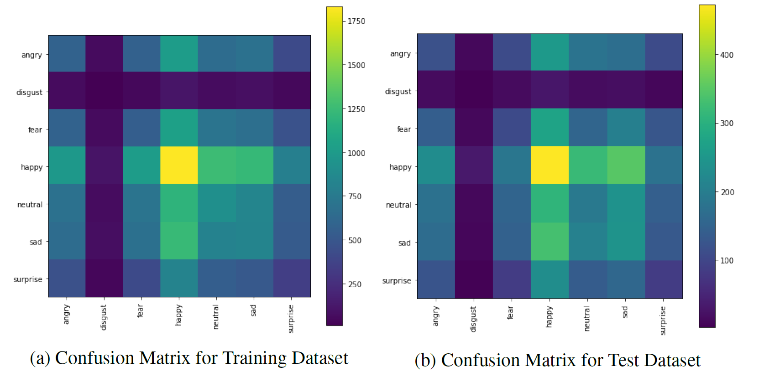
CONFUSION MATRIX
CONFUSION MATRIX

Slide 12
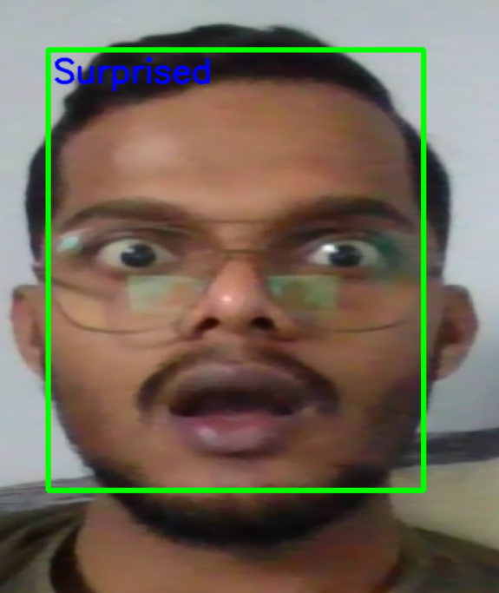
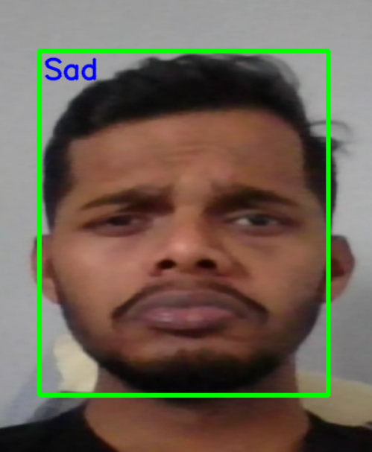
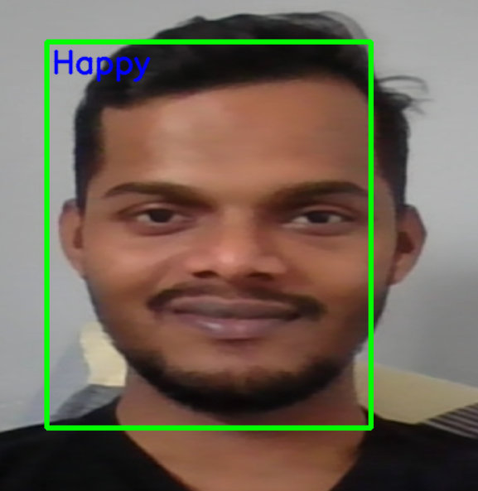
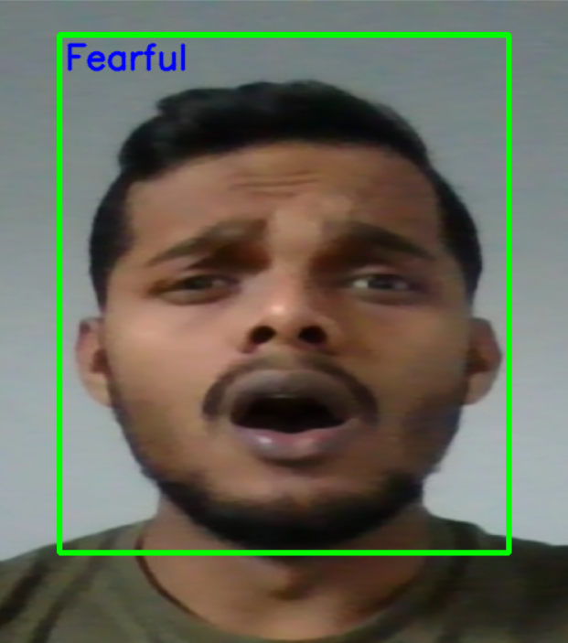

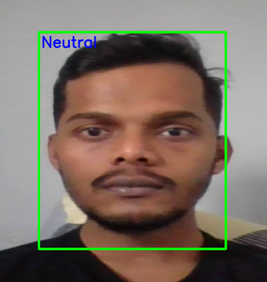
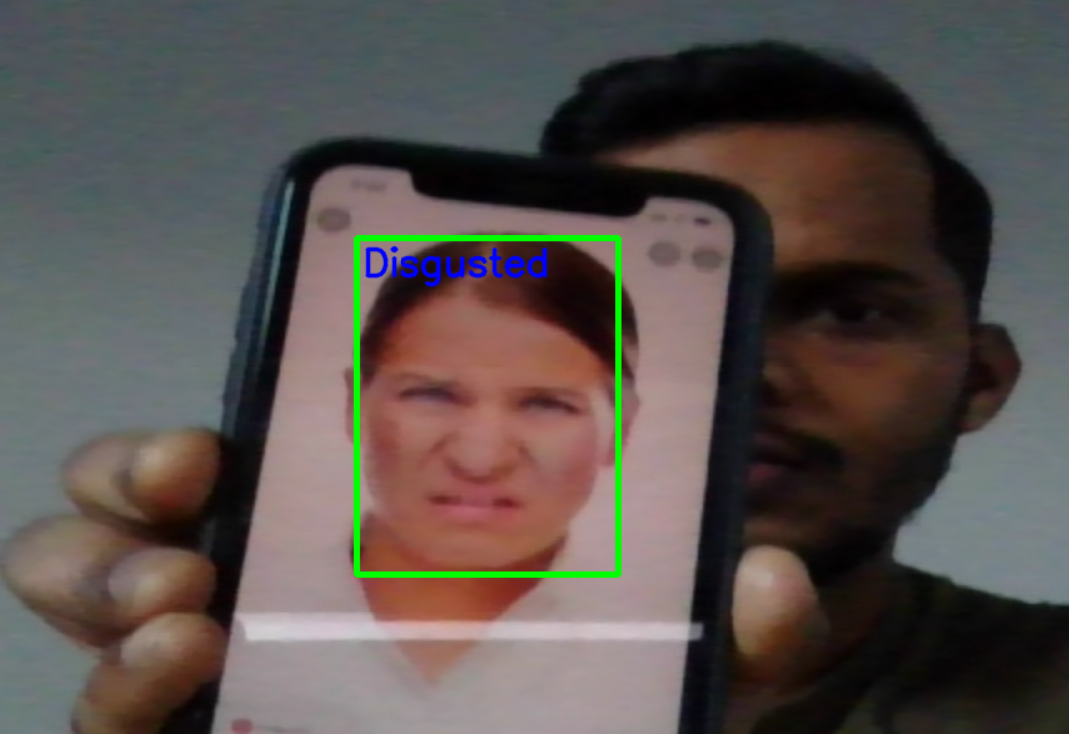
LIVE PREDICTION
LIVE PREDICTION
Surprised
Sad
Happy
Fearful
Angry
Neutral
Disgusted

Slide 13

FUTURE SCOPE
Modelling with multiple forms of data
Improve the accuracy of the trained model
Recognize the emotion even while face is inverted
Implement in a live scenario
Robust and efficient model
Improvement in parameter tuning

Slide 14
Thank You!

